Slide 1
What Causes Housing Prices to Fluctuate
Marc Riley
Notes:
ID=d924773e-9a16-4d6d-9803-8cb819e99682
Recipe=text_billboard
Type=TextOnly
Variant=0
FamilyID=AccentBoxWalbaum_Zero

Slide 2
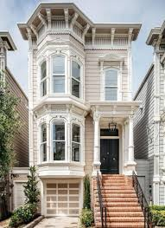
Problem
Are there any variables that are directly related to the price of a home? If we can predict this it can help us determine a fair price/value for new homes.

Slide 3
Variables
Sale Price
This variable records the price at which a house was sold at
Bedrooms
This variable records how many bedrooms are in each house my assumption would be a house with more bedrooms would sell for a higher price
Total Square Feet
This variable calculates the total living square feet in a house my first assumption is that the higher this variable is the higher the price will be
Building Grade
This variable shows how good of a condition a home is in the scale ranges from 0 to 13 with 0 being the worst condition and 13 being the best original assumption would be that a higher building grade will mean a greater sale price
Year Built
This variable shows what year the house was constructed in

Slide 4
Characteristics of the variables
Sale Price | sale_reason | sale_instrument | zip5 | lon | lat | building_grade | square_feet_total_living | bedrooms | bath_full_count | bath_half_count | bath_3qtr_count | year_built | year_renovated | sq_ft_lot | present_use
count | 1.286500e+04 | 12865.000000 | 12865.000000 | 12865.000000 | 12865.000000 | 12865.000000 | 12865.000000 | 12865.000000 | 12865.000000 | 12865.000000 | 12865.000000 | 12865.000000 | 12865.000000 | 12865.000000 | 1.286500e+04 | 12865.000000
mean | 6.607377e+05 | 1.550019 | 3.677730 | 98052.540381 | -122.079216 | 47.683576 | 8.240420 | 2539.506180 | 3.478663 | 1.798445 | 0.613370 | 0.493976 | 1993.002643 | 26.244306 | 2.222857e+04 | 6.597746
std | 4.043811e+05 | 2.675205 | 3.310712 | 1.695107 | 0.052210 | 0.025770 | 1.092624 | 989.817562 | 0.876127 | 0.650797 | 0.526276 | 0.650044 | 17.220168 | 227.482581 | 5.693329e+04 | 30.211924
min | 6.980000e+02 | 0.000000 | 0.000000 | 98052.000000 | -122.164280 | 47.456347 | 2.000000 | 240.000000 | 0.000000 | 0.000000 | 0.000000 | 0.000000 | 1900.000000 | 0.000000 | 7.850000e+02 | 0.000000
25% | 4.600000e+05 | 1.000000 | 3.000000 | 98052.000000 | -122.119726 | 47.665614 | 8.000000 | 1820.000000 | 3.000000 | 1.000000 | 0.000000 | 0.000000 | 1979.000000 | 0.000000 | 5.355000e+03 | 2.000000
50% | 5.930000e+05 | 1.000000 | 3.000000 | 98052.000000 | -122.100252 | 47.687425 | 8.000000 | 2420.000000 | 4.000000 | 2.000000 | 1.000000 | 0.000000 | 1998.000000 | 0.000000 | 7.965000e+03 | 2.000000
75% | 7.500000e+05 | 1.000000 | 3.000000 | 98053.000000 | -122.026293 | 47.704956 | 9.000000 | 3110.000000 | 4.000000 | 2.000000 | 1.000000 | 1.000000 | 2007.000000 | 0.000000 | 1.263200e+04 | 2.000000
max | 4.400000e+06 | 19.000000 | 27.000000 | 98074.000000 | -121.949858 | 47.732546 | 13.000000 | 13540.000000 | 11.000000 | 23.000000 | 8.000000 | 8.000000 | 2016.000000 | 2016.000000 | 1.631322e+06 | 300.000000

Slide 5
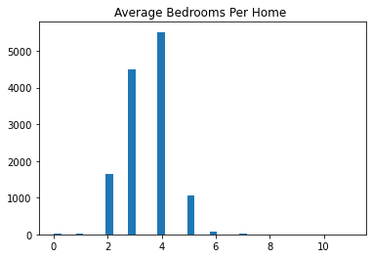
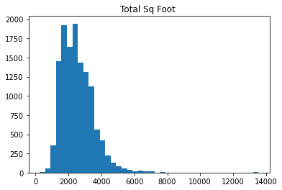
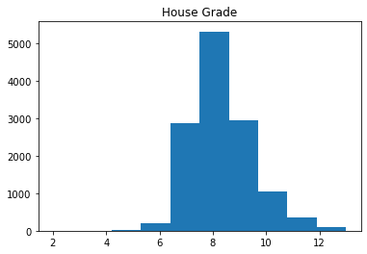
Histograms
Bedrooms Per Home
Total Sq Feet
House Grade
Notes:
These three histograms starting on the far left show average bedrooms per home, these graph appears to be somewhat normally distributed with 3.5 rooms being the mean. Since the STD for bedrooms is .87 and 3 away from the mean would make anything past 6 bedrooms an outlier. With such a large data set and so few bedrooms being an outlier I am not very concerned with this. The middle histogram shows total sq feet for each house which appears to be skewed to the right with a mean of 2539 Sq feet

Slide 6
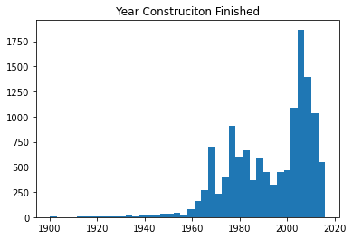
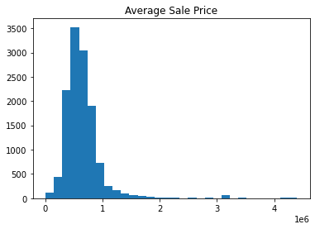
Histograms Cont
Year Construction was Finished
Average Sale Price

Slide 7
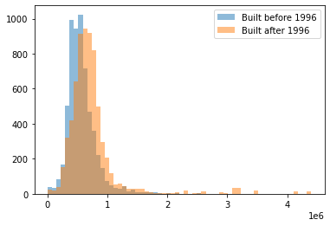
PMF of The year when a home was constructed
Notes:
This PMF shows the year when each home was constructed. The blue shows homes before 1996 and orange after. This confirms that newer homes tend to get bough for a higher price. Also many of our outliers appear to be from newer homes.

Slide 8
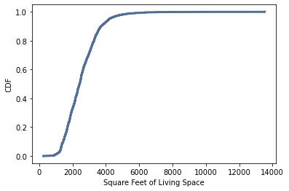
CDF of Square Feet of Total Living Space
Notes:
This CDF shows that most of our homes fall between 2000 and 4000 sq feet of living space.

Slide 9
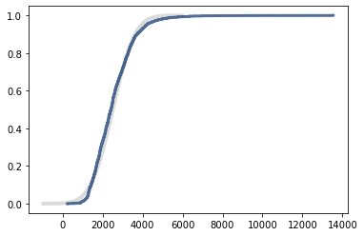
Analytical Distribution of Sq Feet
Notes:
Our analytical distribution tells us our model is almost normally distributed. If our data was perfect there would be more homes with less sq feet and more homes with more sq feet as well.

Slide 10
Correlation Chart
 | Sale Price | sale_reason | sale_instrument | zip5 | lon | lat | building_grade | square_feet_total_living | bedrooms | bath_full_count | bath_half_count | bath_3qtr_count | year_built | year_renovated | sq_ft_lot | present_use
Sale Price | 1.000000 | -0.116644 | -0.040706 | 0.060149 | 0.046847 | 0.021198 | 0.391229 | 0.454588 | 0.225467 | 0.284849 | 0.165828 | 0.035742 | 0.242671 | 0.032864 | 0.119812 | -0.025429
sale_reason | -0.116644 | 1.000000 | 0.399857 | 0.001393 | -0.013532 | -0.031966 | -0.078912 | -0.065213 | -0.056284 | -0.073128 | -0.051526 | -0.000687 | -0.120238 | 0.024344 | 0.034006 | -0.002063
sale_instrument | -0.040706 | 0.399857 | 1.000000 | -0.016104 | -0.021921 | -0.049666 | -0.048443 | -0.007001 | -0.001835 | -0.025098 | -0.034397 | 0.015641 | -0.096159 | 0.011207 | 0.124543 | 0.001794
zip5 | 0.060149 | 0.001393 | -0.016104 | 1.000000 | 0.353371 | -0.134312 | 0.103989 | 0.095659 | -0.036623 | 0.098245 | 0.024996 | -0.074930 | 0.100990 | -0.005763 | 0.089845 | 0.029113
lon | 0.046847 | -0.013532 | -0.021921 | 0.353371 | 1.000000 | -0.041015 | 0.033126 | 0.068571 | -0.241496 | 0.131391 | 0.025742 | -0.136444 | 0.342357 | -0.020174 | 0.201085 | 0.128447
lat | 0.021198 | -0.031966 | -0.049666 | -0.134312 | -0.041015 | 1.000000 | 0.012180 | -0.063836 | -0.154817 | 0.077571 | -0.042526 | -0.100448 | 0.377872 | -0.091741 | -0.145456 | 0.017607
building_grade | 0.391229 | -0.078912 | -0.048443 | 0.103989 | 0.033126 | 0.012180 | 1.000000 | 0.745181 | 0.342566 | 0.459416 | 0.280766 | 0.069514 | 0.361930 | -0.019025 | 0.138431 | 0.044723
square_feet_total_living | 0.454588 | -0.065213 | -0.007001 | 0.095659 | 0.068571 | -0.063836 | 0.745181 | 1.000000 | 0.575347 | 0.517784 | 0.316857 | 0.198674 | 0.306427 | 0.043396 | 0.234105 | 0.032494
bedrooms | 0.225467 | -0.056284 | -0.001835 | -0.036623 | -0.241496 | -0.154817 | 0.342566 | 0.575347 | 1.000000 | 0.304599 | 0.162334 | 0.247340 | 0.012442 | 0.014924 | 0.047173 | -0.038895
bath_full_count | 0.284849 | -0.073128 | -0.025098 | 0.098245 | 0.131391 | 0.077571 | 0.459416 | 0.517784 | 0.304599 | 1.000000 | 0.217315 | -0.379106 | 0.452600 | 0.022181 | 0.046993 | 0.033650
bath_half_count | 0.165828 | -0.051526 | -0.034397 | 0.024996 | 0.025742 | -0.042526 | 0.280766 | 0.316857 | 0.162334 | 0.217315 | 1.000000 | -0.315843 | 0.198490 | -0.026657 | 0.028105 | 0.019313
bath_3qtr_count | 0.035742 | -0.000687 | 0.015641 | -0.074930 | -0.136444 | -0.100448 | 0.069514 | 0.198674 | 0.247340 | -0.379106 | -0.315843 | 1.000000 | -0.152355 | 0.018359 | 0.049156 | 0.001521
year_built | 0.242671 | -0.120238 | -0.096159 | 0.100990 | 0.342357 | 0.377872 | 0.361930 | 0.306427 | 0.012442 | 0.452600 | 0.198490 | -0.152355 | 1.000000 | -0.224586 | -0.134914 | 0.130783
year_renovated | 0.032864 | 0.024344 | 0.011207 | -0.005763 | -0.020174 | -0.091741 | -0.019025 | 0.043396 | 0.014924 | 0.022181 | -0.026657 | 0.018359 | -0.224586 | 1.000000 | 0.063208 | -0.017558
sq_ft_lot | 0.119812 | 0.034006 | 0.124543 | 0.089845 | 0.201085 | -0.145456 | 0.138431 | 0.234105 | 0.047173 | 0.046993 | 0.028105 | 0.049156 | -0.134914 | 0.063208 | 1.000000 | 0.059321
present_use | -0.025429 | -0.002063 | 0.001794 | 0.029113 | 0.128447 | 0.017607 | 0.044723 | 0.032494 | -0.038895 | 0.033650 | 0.019313 | 0.001521 | 0.130783 | -0.017558 | 0.059321 | 1.000000
Notes:
This correlation chart was used to pick the variables that have a strong relationship with sale price.

Slide 11
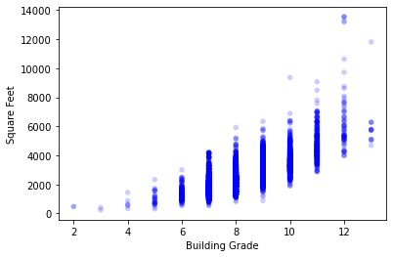
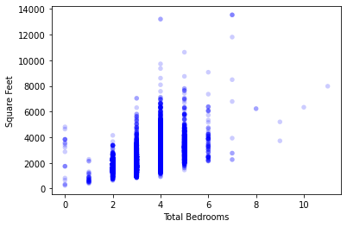
Scatter Plots
Building Grade vs Square Feet
Total Bedrooms vs Square Feet
Notes:
These scatter plots were used to find a rather unique relationship. It appears that the more SQ Feet a house has the higher the chance it will score a good building grade score. The second scatter plot is used to show a rather obvious relationship the more bedrooms that are in a house the more square feet it has.

Slide 12

Regression Analysis
For every additional square foot added the price will rise by 183$
Notes:
This coefficient means for every square foot the sale price changes by 183 dollars.

